Slide 1


Website Title:
Initial
Final

Slide 2

Website Purpose
(Name of our Website) e-commerce platform that primarily focuses on fashion and clothing. Its purpose is to provide consumers with a wide range of trendy and affordable clothing, accessories, and fashion items.

Slide 3

Target Audience
Individuals who are interested in fashion and are looking for trendy, affordable clothing and accessories.
Young Adults and Millennials
Fashion Enthusiasts
Students
Online Shopper
Social Media Users
Fashion Bloggers and Influencers
Global Audience
Budget Conscious Shoppers

Slide 4
Site Map
SnS
Website
Landing Page
main
Men’s
Women’s
Kids
Profile
Favorites
Cart
page
page
page
Log-in & Sign-up
Fav page
Add to Cart page

Slide 5
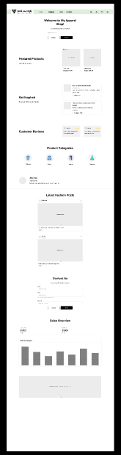
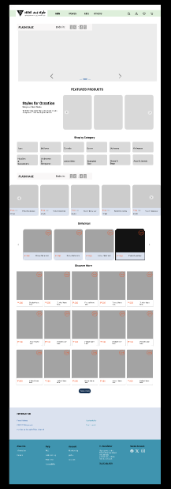
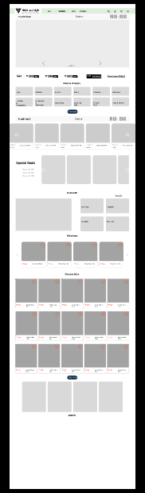
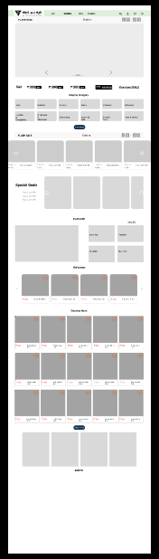
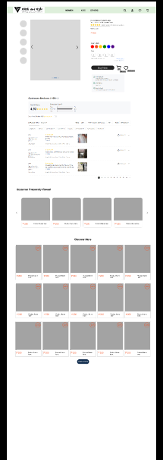
Mock-up pg.1
https://www.figma.com/proto/A0dajzEb2mdkDyiGZXNFcM/WireFrame?page-id=0%3A1&type=design&node-id=30-4&viewport=-168%2C-91%2C0.15&t=B1BrCrYItLfzcwhm-1&scaling=scale-down-width&mode=design

Slide 6
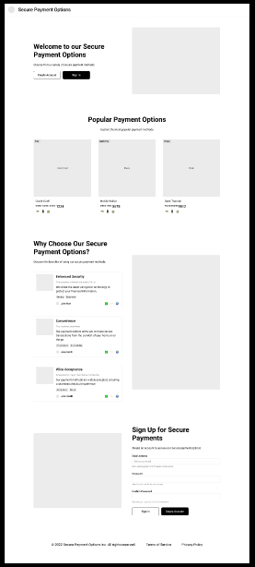
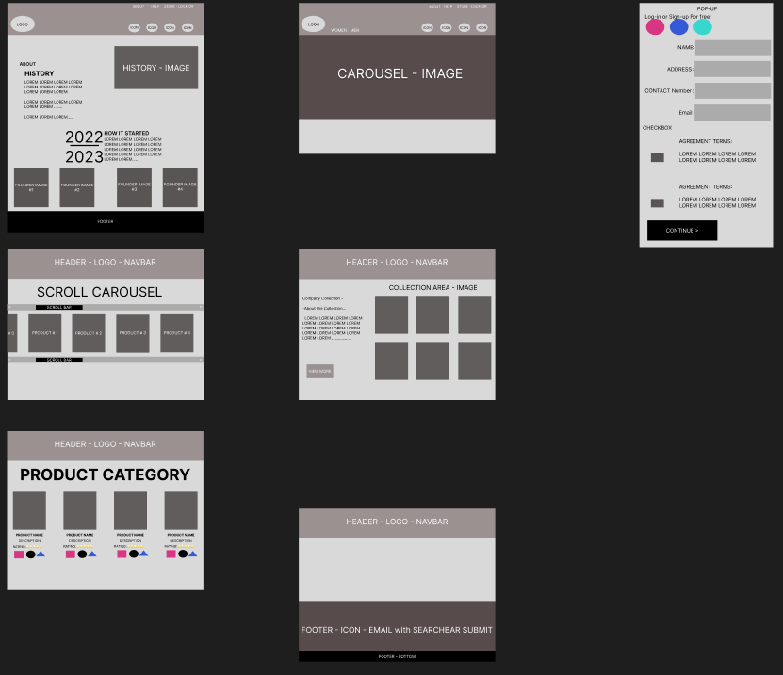
Mock up pg.2

Slide 7

Color Pallettes
Initial
Pre-Final
#0b0c0c
##ffffffff
#333333
#f1511b

Slide 8
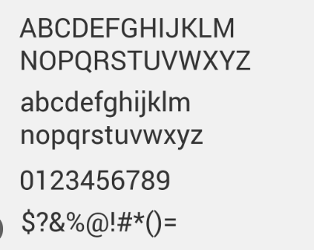
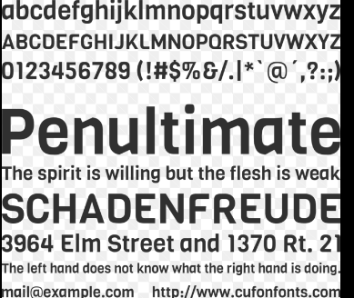
Font(s)
Roboto
Viga

